Slide 1
Testing Session-#

Slide 2
Agenda
Testing Principles

Slide 3
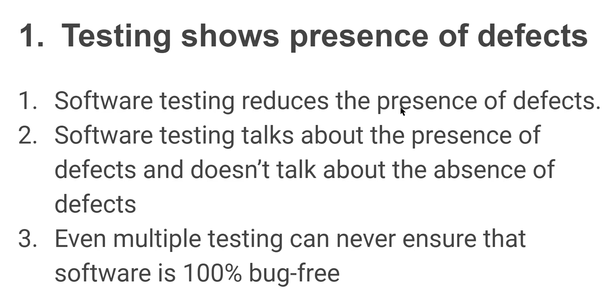

Slide 4
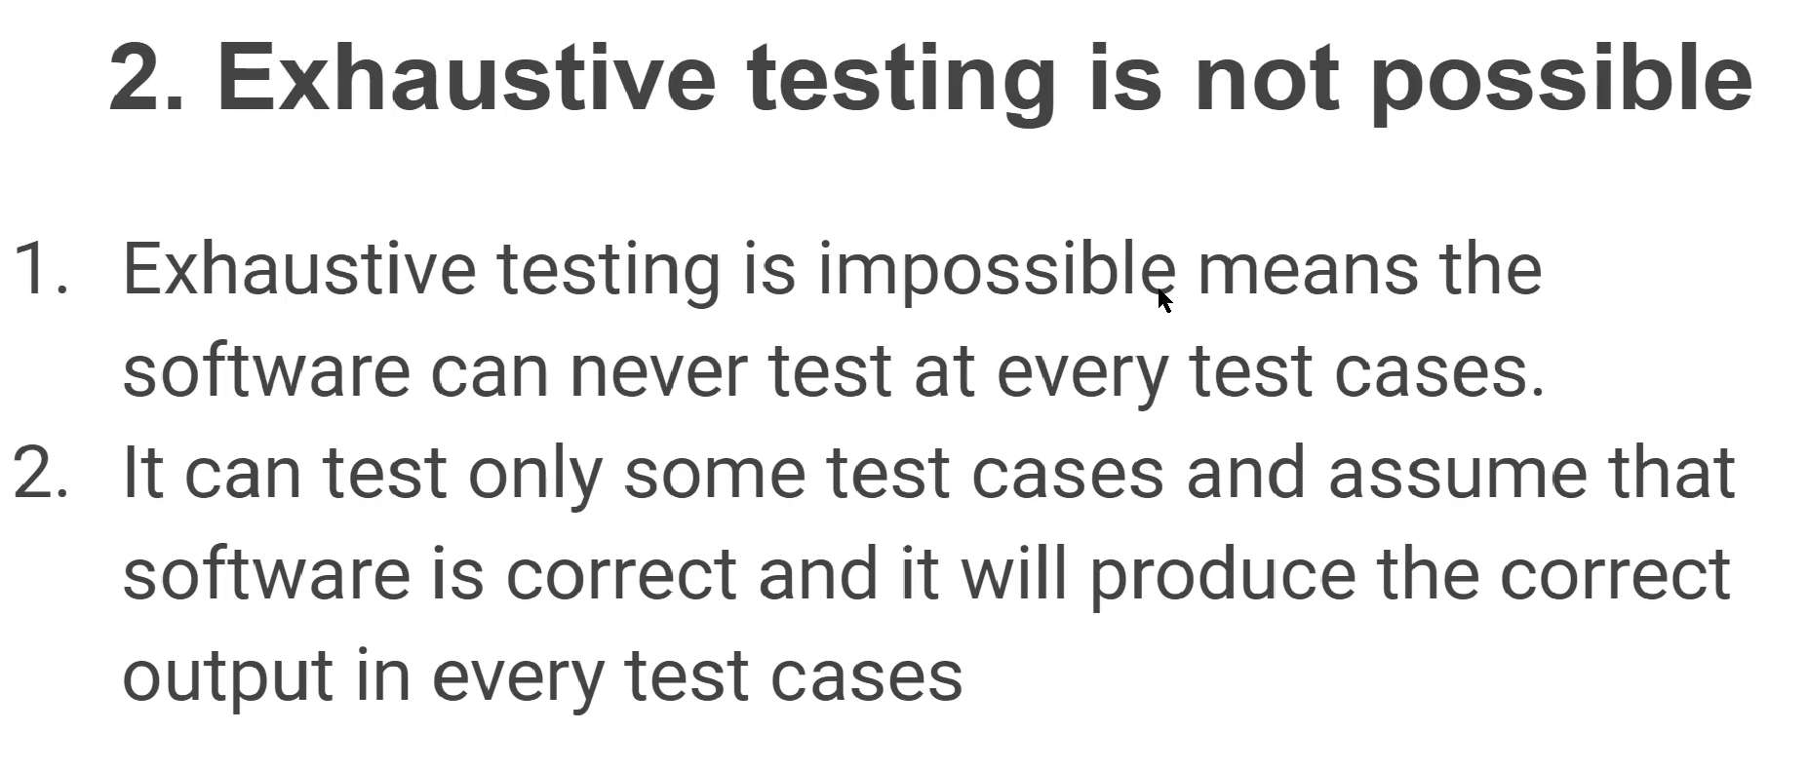

Slide 5
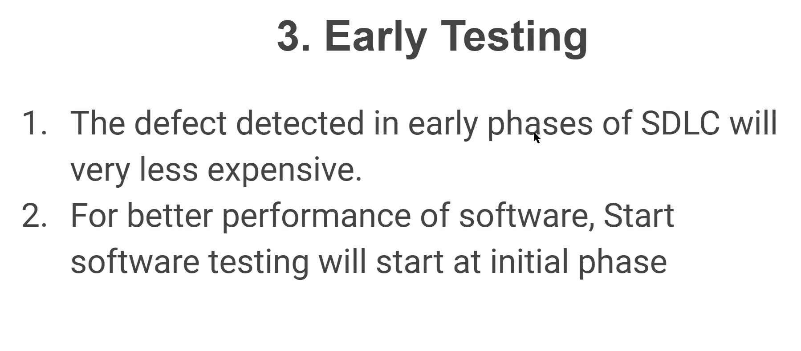

Slide 6
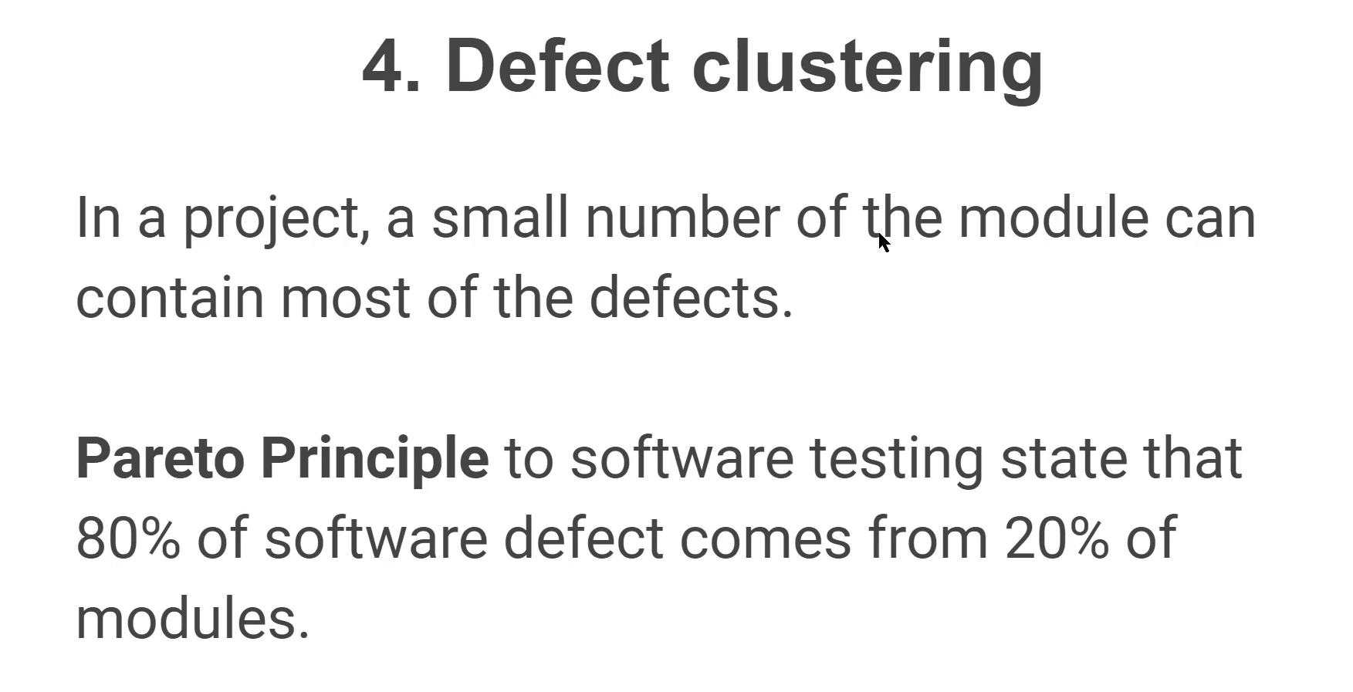

Slide 7
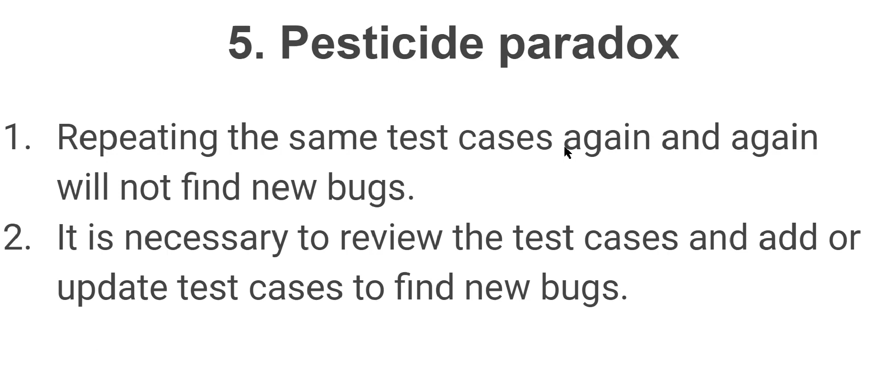

Slide 8
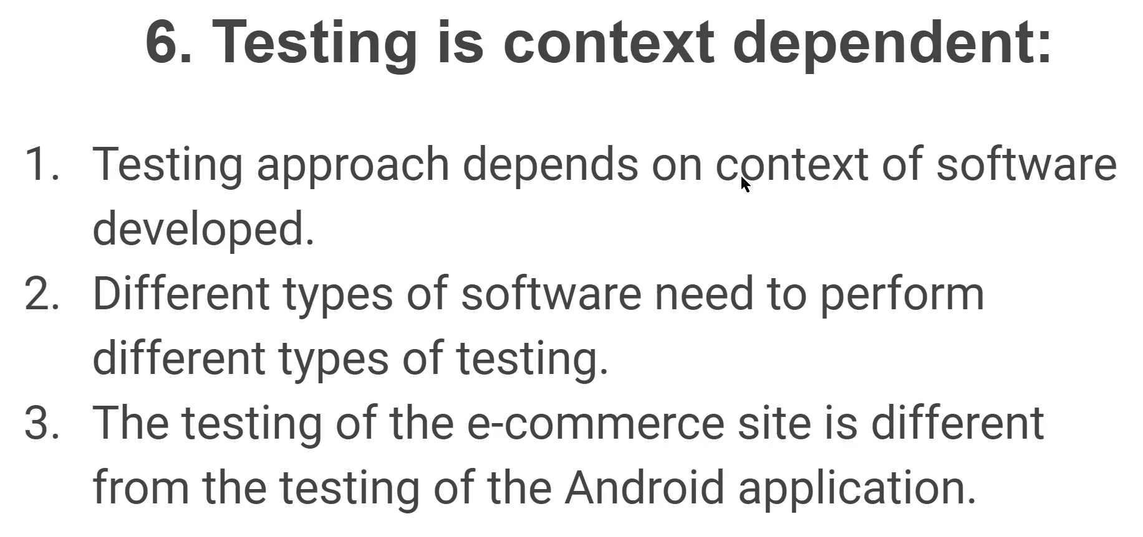

Slide 9
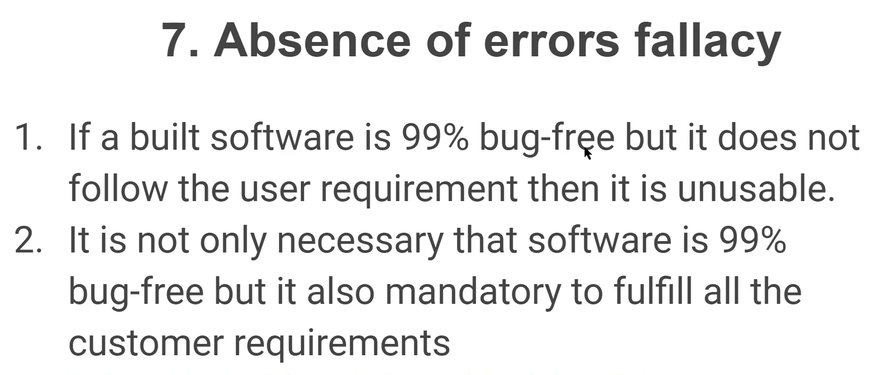

Slide 10

Any Queries?

Slide 11
Thank You
Mr.SubbaRao (Relationship Manager)
Contact:9059002244

